Slide 1
The Pharmaceutical Myth
Letting Food be Your Medicine is the Answer for Perfect Health
© 2014 by Gerald Roliz, CNC
Notes:
Ask the audience 2 questions:
1) How many of you believe to some degree that the quality of your diet influences the quality of your health?
2) How many of you have a child, niece or nephew that you care about?

Slide 2
Disclaimer
The information presented here is intended for educational purposes only. These statements have not been evaluated by the FDA and are not intended to diagnose, cure, treat, or prevent disease. If you have a medical condition or concern, please consult the appropriate healthcare professional.
The information in this presentation should not be constructed as a claim or representation that any procedure or product mentioned constitutes a specific cure, palliative or remedy for any condition.
The material and information contained in this presentation is not for the diagnosis or treatment of disease. They are designed to assist doctors and other healthcare practitioners in evaluating the patients metabolic and nutritional status. The information is also intended to help determine those foods and food supplements that are either excessive or insufficient in the patient’s diet. This allows for a better understanding of balanced body biochemistry.
The information presented is for educational purposes only. It is the sole responsibility of the healthcare practitioner and viewer using this information to determine if what is outlined herein is appropriate for his or her purpose.
Notes:
Can read out the 1st paragraph.

Slide 3
About The Book
Purpose: This book has been written to educate readers how to work with a holistic health care practitioner and medical doctor to become healthy and un-medicated
Benefits: This book empowers readers with information intuitively known to be true, but just needed to be heard from an insider
Call to Action: Carry this book everywhere so that others may be reminded that food is our best source of nutrition
Notes:
Purpose: Propose an integrated healthcare model that includes holistic health care practitioners.
Call to action: Give an example how the cover of the book has engaged others’ attention.

Slide 4
Author Background
Graduated from U.C. Berkeley after studying Psychology and Molecular & Cell Biology in 2001
Became a pharmaceutical sales representative and believed the products he sold would save the world
Then he picked up a magazine,
and that changed EVERYTHING…

Slide 5
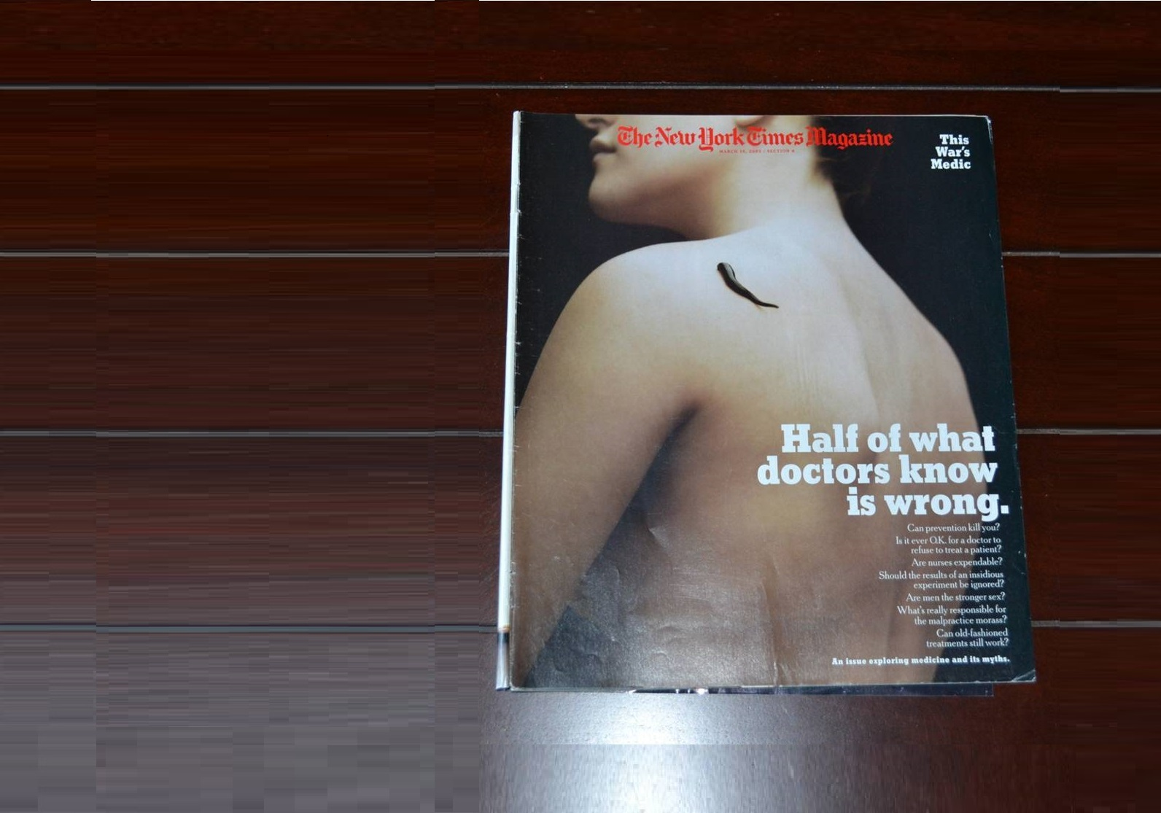
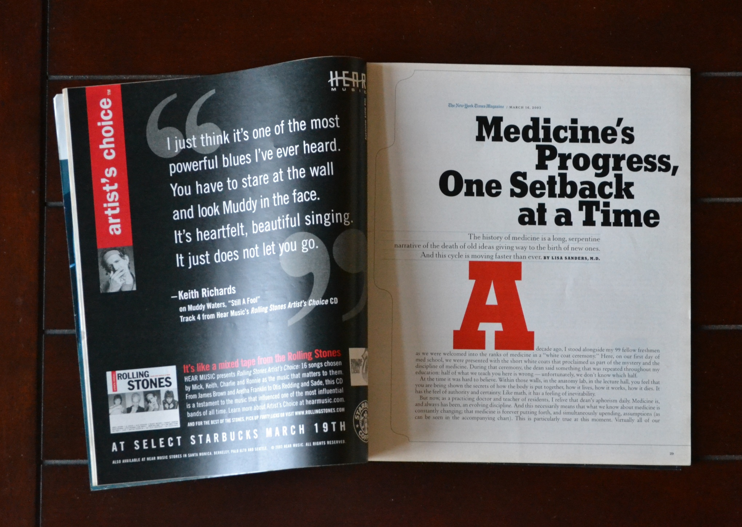
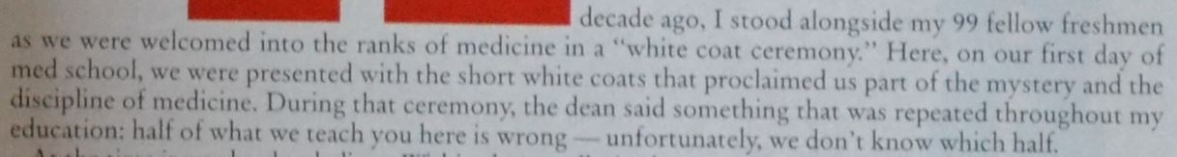
The New York Times Magazine, March 16, 2003 (pages 29-31)
Notes:
March 16, 2003 edition of The New York Times Magazine (pages 29-31) - Lisa Sanders, MD states, “Half of what we teach you here is wrong – unfortunately, we don’t know which half.”

Slide 6
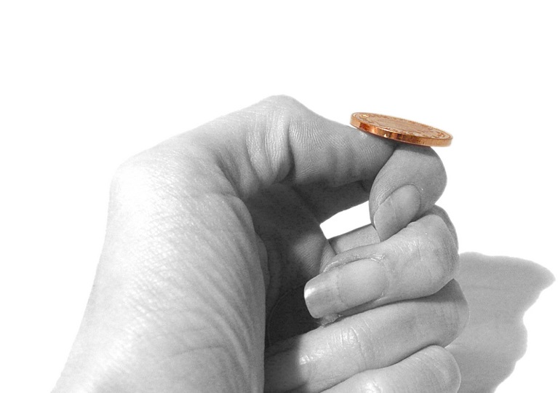
Real health solutions,
should be more certain than a coin flip…

Slide 7
Linking Malnutrition to Poor Health
Vitamin C deficiency results in the development of Scurvy
Vitamin D deficiency results in the development of Rickets
Vitamin B₁ deficiency results in the development of Beri Beri
Vitamin B₃ deficiency results in the development of Pellagra
Iron deficiency results in the development of Anemia
What if every health challenge was linked,
to some form of nutritional deficiency?

Slide 8
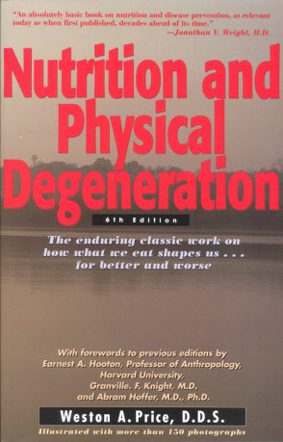
Optimal Nutrition is linked to Perfect Health
Dr. Weston A. Price studied over 14 villages of indigenous populations who consumed traditional foods AND had no incidence of cancer or any chronic illness.
Dr. D.W. Cavanaugh
of Cornell University stated:
“There is only one major disease and that is malnutrition.”
Notes:
Give one example of a society that reversed their health issues by returning to a traditional foods diet. Can discuss the natives of Tonga who sold Copra (dried coconut meat) to the Europeans. In exchange, they were left with white sugar & white flour. The children’s health declined. Copra prices then dropped globally and the Europeans no longer came to trade. The children’s health issues (including any cavities) reversed with the reintroduction of traditional foods.

Slide 9
Causes of Malnutrition
Soil Depletion: Loss of nutrient rich top soil leads to a nutrient-poor food supply
Food Manipulation: Genetic engineering, genetic modification, hybridization, artificial selection and crop manipulation technologies alter nutrient composition with no promise of adequate nourishment
Food Processing: Pasteurization, hydrogenation, homogenization, bleaching, deodorization, irradiation, fumigation, chemicalization and refinement of whole food sources destroy the delicate nutrients essential to health and introduces toxins into our food supply
Notes:
Soils are under nourishing our foods: “The amount of iron found in one cup of spinach in 1945 is equal to the amount found in 65 cups today.”
Modern day farmers are focused on NPK, but neglect to replenish the trace minerals our body requires as endocrine activators.

Slide 10
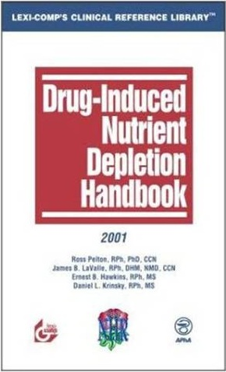
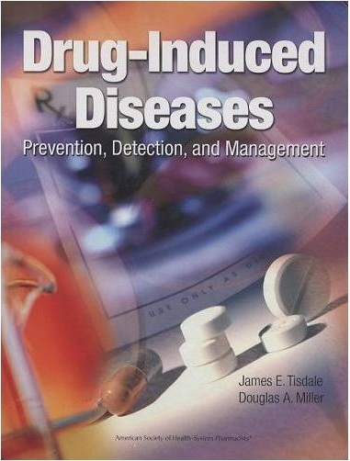
A Recipe for a Sicker Society
Malnutrition Causes Disease
Pharmaceutical Drugs
Exacerbate Malnutrition
Pharmaceutical Drugs
Cause Additional Diseases
Notes:
The current “sick care” paradigm. In order to have patients on a “health care” paradigm, they must focus on the basics of human health, which is whole food nutrition (with chiropractic and/or acupuncture).

Slide 11
Over 61% of the adult population in the United States is on a prescription pharmaceutical drug.¹
1. The U.S. Health System in Perspective: A Comparison of Twelve Industrialized Nations
Notes:
Our society has more people declining in health more rapidly due to drug-induced nutrient depletions. This is a trend we must reverse.

Slide 12
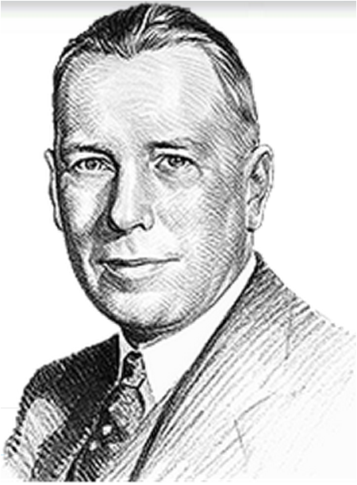
One of the biggest tragedies of human civilization is the precedence of chemical therapy over nutrition. It's a substitution of artificial therapy over natural, of poisons over food, in which we are feeding people poisons trying to correct the reactions of starvation. You know how ridiculous this is. You all know how widely it is being done.
Jan. 12, 1951
Dr. Royal Lee
Notes:
Explain the link between Dr. Weston A. Price & Dr. Royal Lee. They met once a month to exchange data and knowledge in nutrition with the other Nutrition Pioneers (Dr. Francis Pottenger, Dr. Melvin Page, Dr. DC Jarvis, etc.) at fireside chats known as the “Jarvis Study Group” Dr. Price learned that the Peruvian natives hiked from the top of the Andes down to the ocean to collect kelp. When Dr. Price asked the natives why do they make a month long trek for seaweed? They responded, “it strengthens the heart.” Dr. Royal Lee concentrated kelp into mineral rich formulas. Dr. Lee also concentrated other foods that the 14 indigenous societies at regularly for optimal health.

Slide 13
YOU WILL LEARN:
To identify which doctor is keeping you sick & which will help you be well
How pharmaceuticals create additional diseases
How most medical doctors are not always looking out for your health
What must be done to avoid unnecessary surgeries
What the perfect diet looks like
Why over-the-counter vitamins don’t always work
How to get to the root cause of any health challenge
Actionable steps to become and remain healthy for your entire life
Notes:
These can be found on the back cover of the book.

Slide 14
Who should read this book?
Every person who desires to be healthy and un-medicated
Every parent who desires their child to live a life, healthy & un-medicated
This book includes the action steps we all must take to ensure
our children and grandchildren have a chance
to live a life, healthy and un-medicated.

Slide 15
www.thepharmaceuticalmyth.com

Slide 16
Thank you for attending!

Slide 17

For More Information
If you have unanswered questions, wish to make a bulk purchase , or hire one of our speakers for a speaking engagement, please contact:
Gerald Roliz, CNC
(408) 915-8895 lectures@thehealingbody.com
Please also visit us online at www.thehealingbody.com

